Slide 1
Lecture 9: Modeling Electromechanical Systems
Finish purely electrical systems
Modeling in the Laplace domain
Loading of cascaded elements
Modeling electromechanical systems
Introduction
Sensors and the measurement system
Actuators (continue with DC motors next class)

Slide 2
Modeling in the Laplace Domain
Idea: model circuits directly in terms of Laplace transformed equations
Complex impedance is treated like resistance
Ohm’s law
Equivalent components in series and parallel

Slide 3
Modeling in the Laplace Domain
Resistors:
Capacitors:
Inductors:

Slide 4
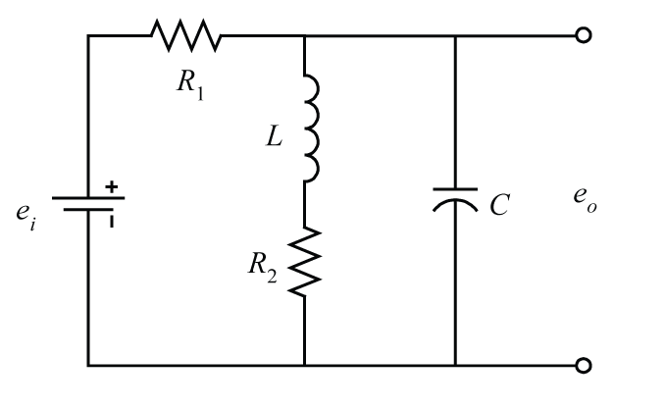
Example
Find the transfer function E_{o}(s)/E_{i}(s)
Notes:
Components are underneath
Make sure to include units

Slide 5
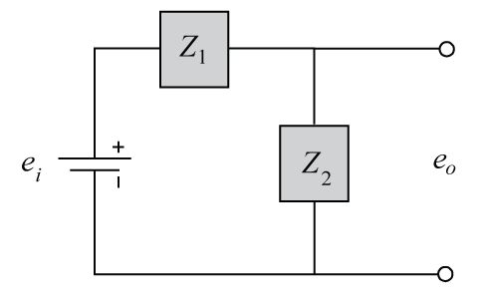
Example (con’t)
Note: this approach is only valid if initial conditions are zero
Notes:
Voltage divider!

Slide 6
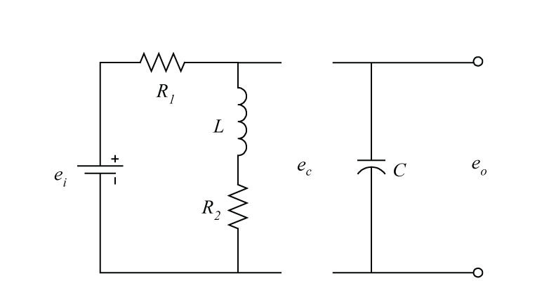
Loading of Cascaded Elements
Consider the two loops separately
Notes:
Note how G(s) doesn’t equal G1(s)G2(s) … current through first loop is affected by the second loop … think of two resistors in series

Slide 7
Loading of Cascaded Elements
Consider the two loops separately
Note that
The second loop loads the first loop
Can add an isolating amplifier to decouple
This is addressed by some simulation software
E_{i}(s)
E_{c}(s)
E_{o}(s)
G₁(s)
G₂(s)
Notes:
Note how G(s) doesn’t equal G1(s)G2(s) … current through first loop is affected by the second loop … think of two resistors in series
Think of a battery in series with a motor

Slide 8
Electromechanical Systems
Most control systems (including automobiles) include electrical and mechanical components
Need components that convert between the domains
Example:
mechanical domain
electrical domain
R
+
E
U
Y
Transducer
Controller
Actuator
Plant
angle
-
torque
speed
voltage
voltage
voltage
Sensor
Notes:
Not all systems have all of these components

Slide 9
Electromechanical Systems
Sensors/Transducers:
often convert mechanical quantities into electrical ones
Piezoelectric materials produce charge when deformed
(ex: accelerometer, microphone, load cell, etc.)
Electrical properties of many materials change with temperature, deformation, etc.
(ex: thermistor, pressure transducer, strain gage)
Motion of a conductor through a magnetic field can induce an emf (ex: LVDT, resolver)
Special materials produce charge in response to light (digital camera, optical encoder)

Slide 10
The Measuring System
Measurement process generally involves multiple elements that each may have dynamics that need to be modeled
Stage 1
transduced
signal
Stage 2
analogous
driving signal
Stage 3
measurand
Sensor
Signal
Conditioning
Readout/
Computation
filter
amplify
integrate
differentiate
DAC
ADC
gauge
LED display
LCD display
speaker
computer

Slide 11
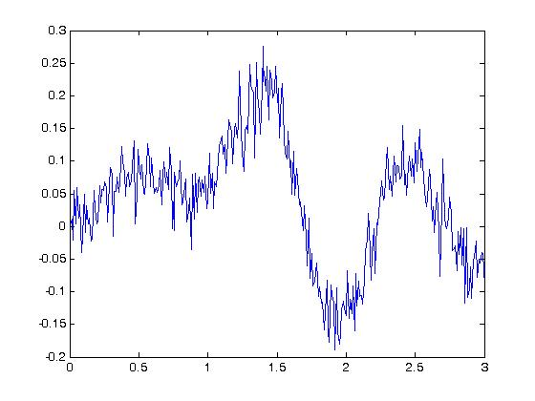
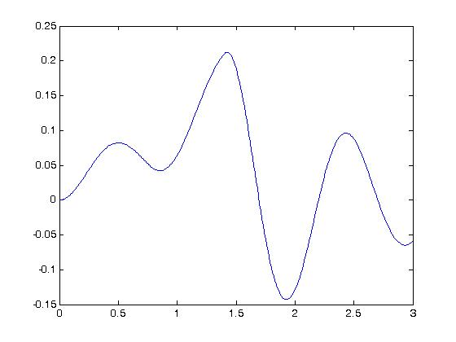
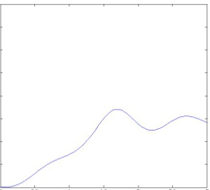
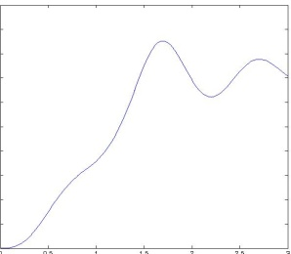

The Measuring System
Example
Stage 1
Stage 2
Stage 3
signal
w/o noise
analogous
to velocity
increased
voltage
accel
voltage
digital
sensor
filter
integrator
amplifier
ADC
Computer

Slide 12
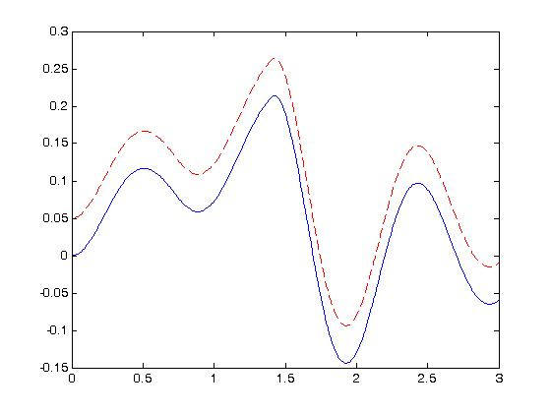
Numerical Integration
Simple approach calculates the area of a series of rectangles
Error accumulates if there is a bias in the measurement

Slide 13
Numerical Differentiation
Simple approach calculates the slope between two points
Large error when noisy measurements are differentiated

Slide 14
Analog to Digital Conversion
An analog signal is sampled at discrete intervals of time and is held
Can introduce time lag and quantization error

Slide 15
Electromagnetic Induction
Like many sensors, some actuators employ electromagnetic induction
Converts electricity into force/torque
Examples: solenoids, speakers, electric motors
Lorentz’s law: A current carrying conductor in a magnetic field generates a force

Slide 16
Solenoid Actuator
Current through coil generates a magnetic field (Ampere’s law)
Magnetic field imparts a force on the iron core
Spring return
Examples include valves and switches, like a car starter
V
Notes:
Not Lorentz’s law
Speakers work on the same basic principle

Slide 17
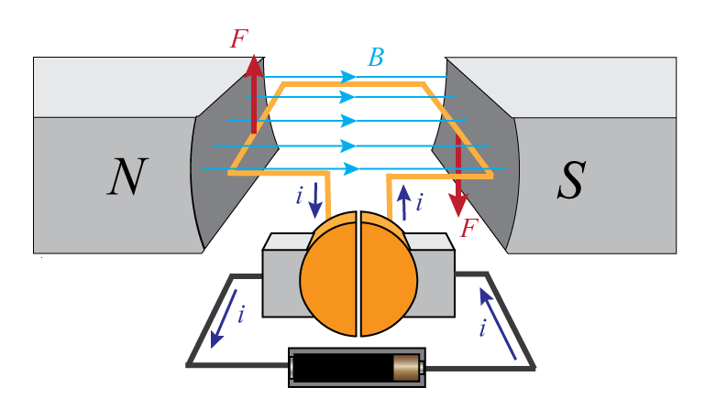
DC Motor
Current moving through a magnetic field induces a force
Parts:
Stator: stationary part (includes the magnet)
Rotor: rotating part (wire coil)
Commutator: half rings that connect to the current source through brushes
Notes:
DC supply
The commutator and brushes ensure that the direction of the current and the magnetic field are always at right angles (maximum force is generated)
In reality
The armature is wound round a piece of iron so that the magnetic field of the magnets does not have to cross a large air gap which would weaken the magnetic field
there will be more than one coil so that the current carrying wire is near the magnets for a higher proportion of the time
Each coil will consist of several wires to increase the torque
More than one pair of magnets will be used (2-pole, 4-pole)

Slide 18
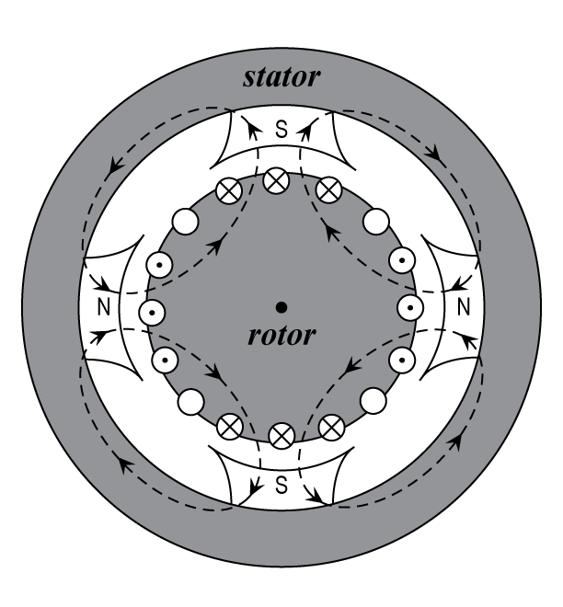
DC Motor
Multiple coils and multiple magnetic pairs ensure current carrying wire near magnet for higher proportion of time
Armature wrapped around iron core so that magnetic field doesn’t have to cross a large air gap

Slide 19
DC Motor
Two approaches to DC motor control ( )
Armature control: change torque by changing current in the armature (rotor)
Field control: change torque by changing the strength of the magnetic field (by changing current through an electromagnet)
Notes:
Generally the armature and field circuit are “separately excited” giving these two control options … or a combination
Two circuits can be put in parallel (shunt) or series, but makes speed and torque control more difficult … can be used in some applications like a starter motor, but generally not the traction motor
Electromagnets tend to be cheaper than permanent magnets, but they generate heat, often can be more efficient though
Generating a constant armature current is more difficult than generating a constant voltage source (back emf?) … field control tends to be slower?

Slide 20
DC Motor
Armature-controlled DC motor model
Model resistance and inductance of the coil as lumped parameters
Same with mechanical inertia and friction
θ

